Slide 1

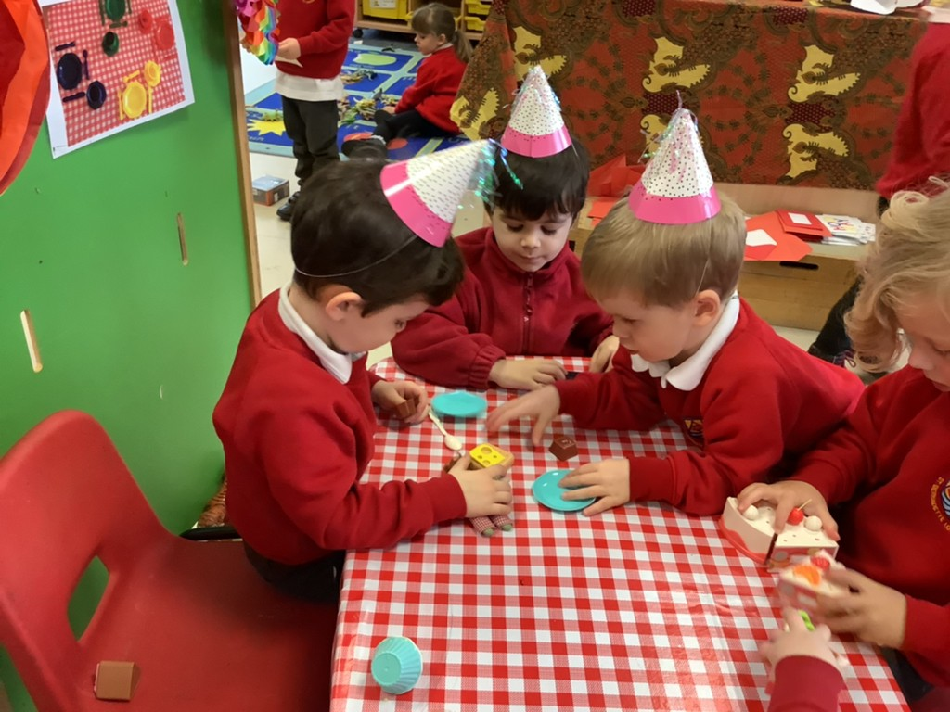
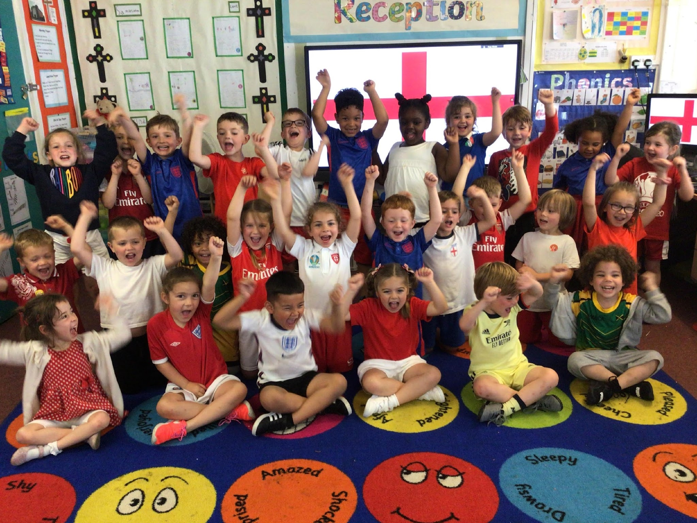
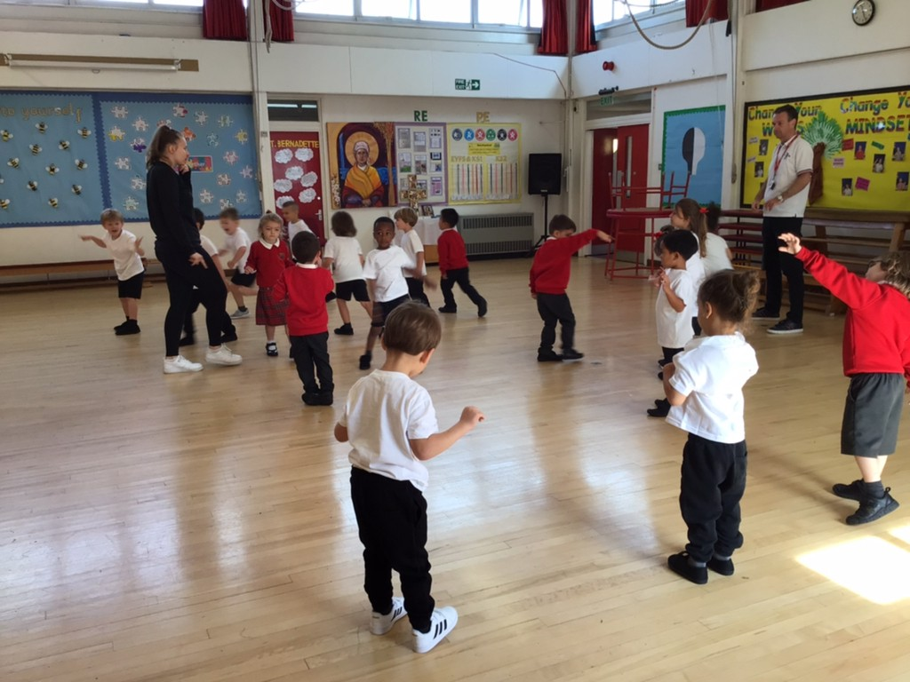
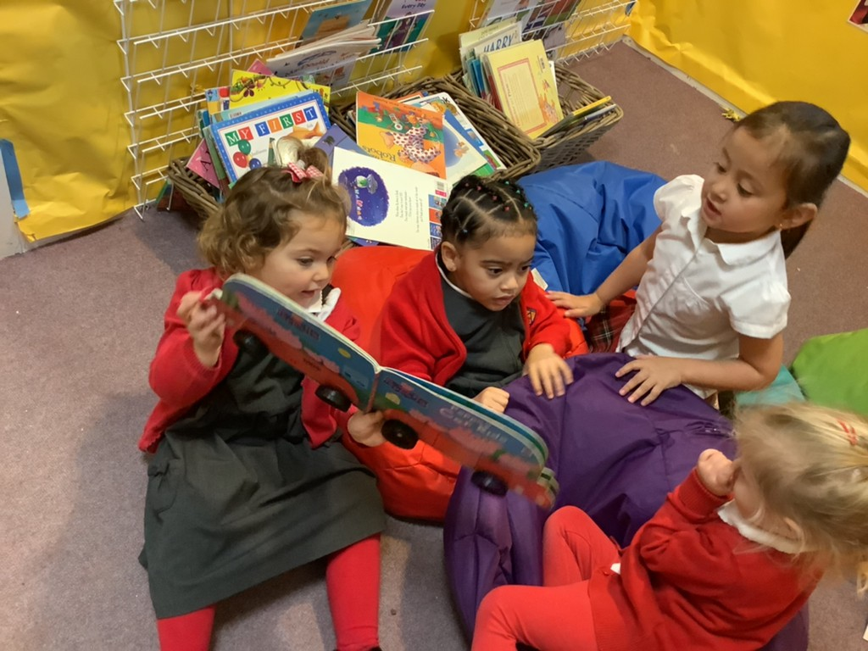
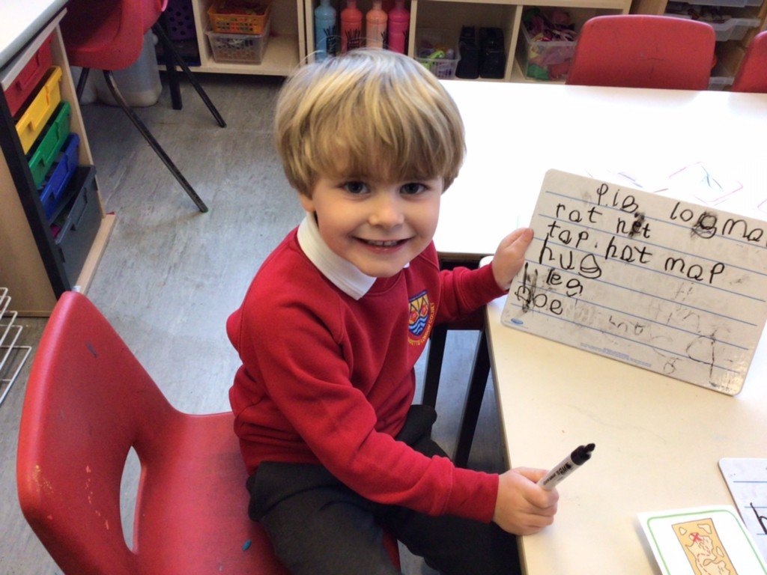
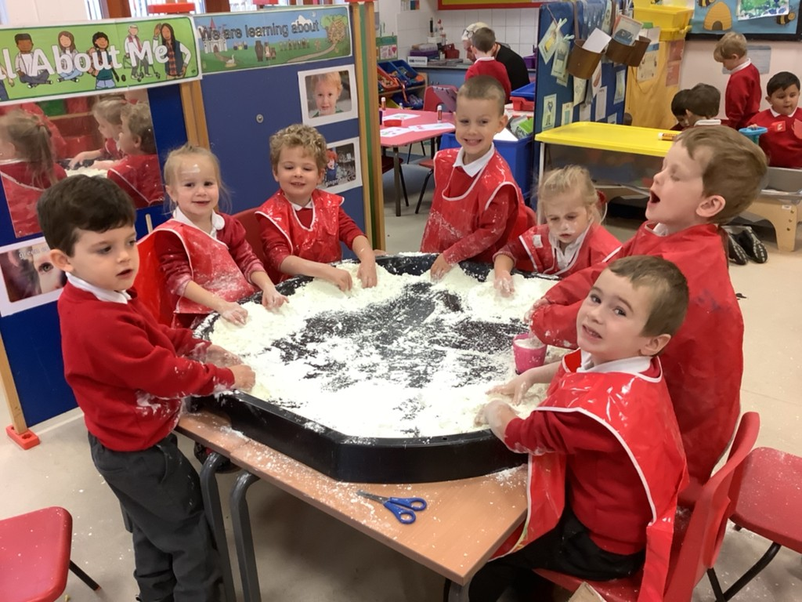
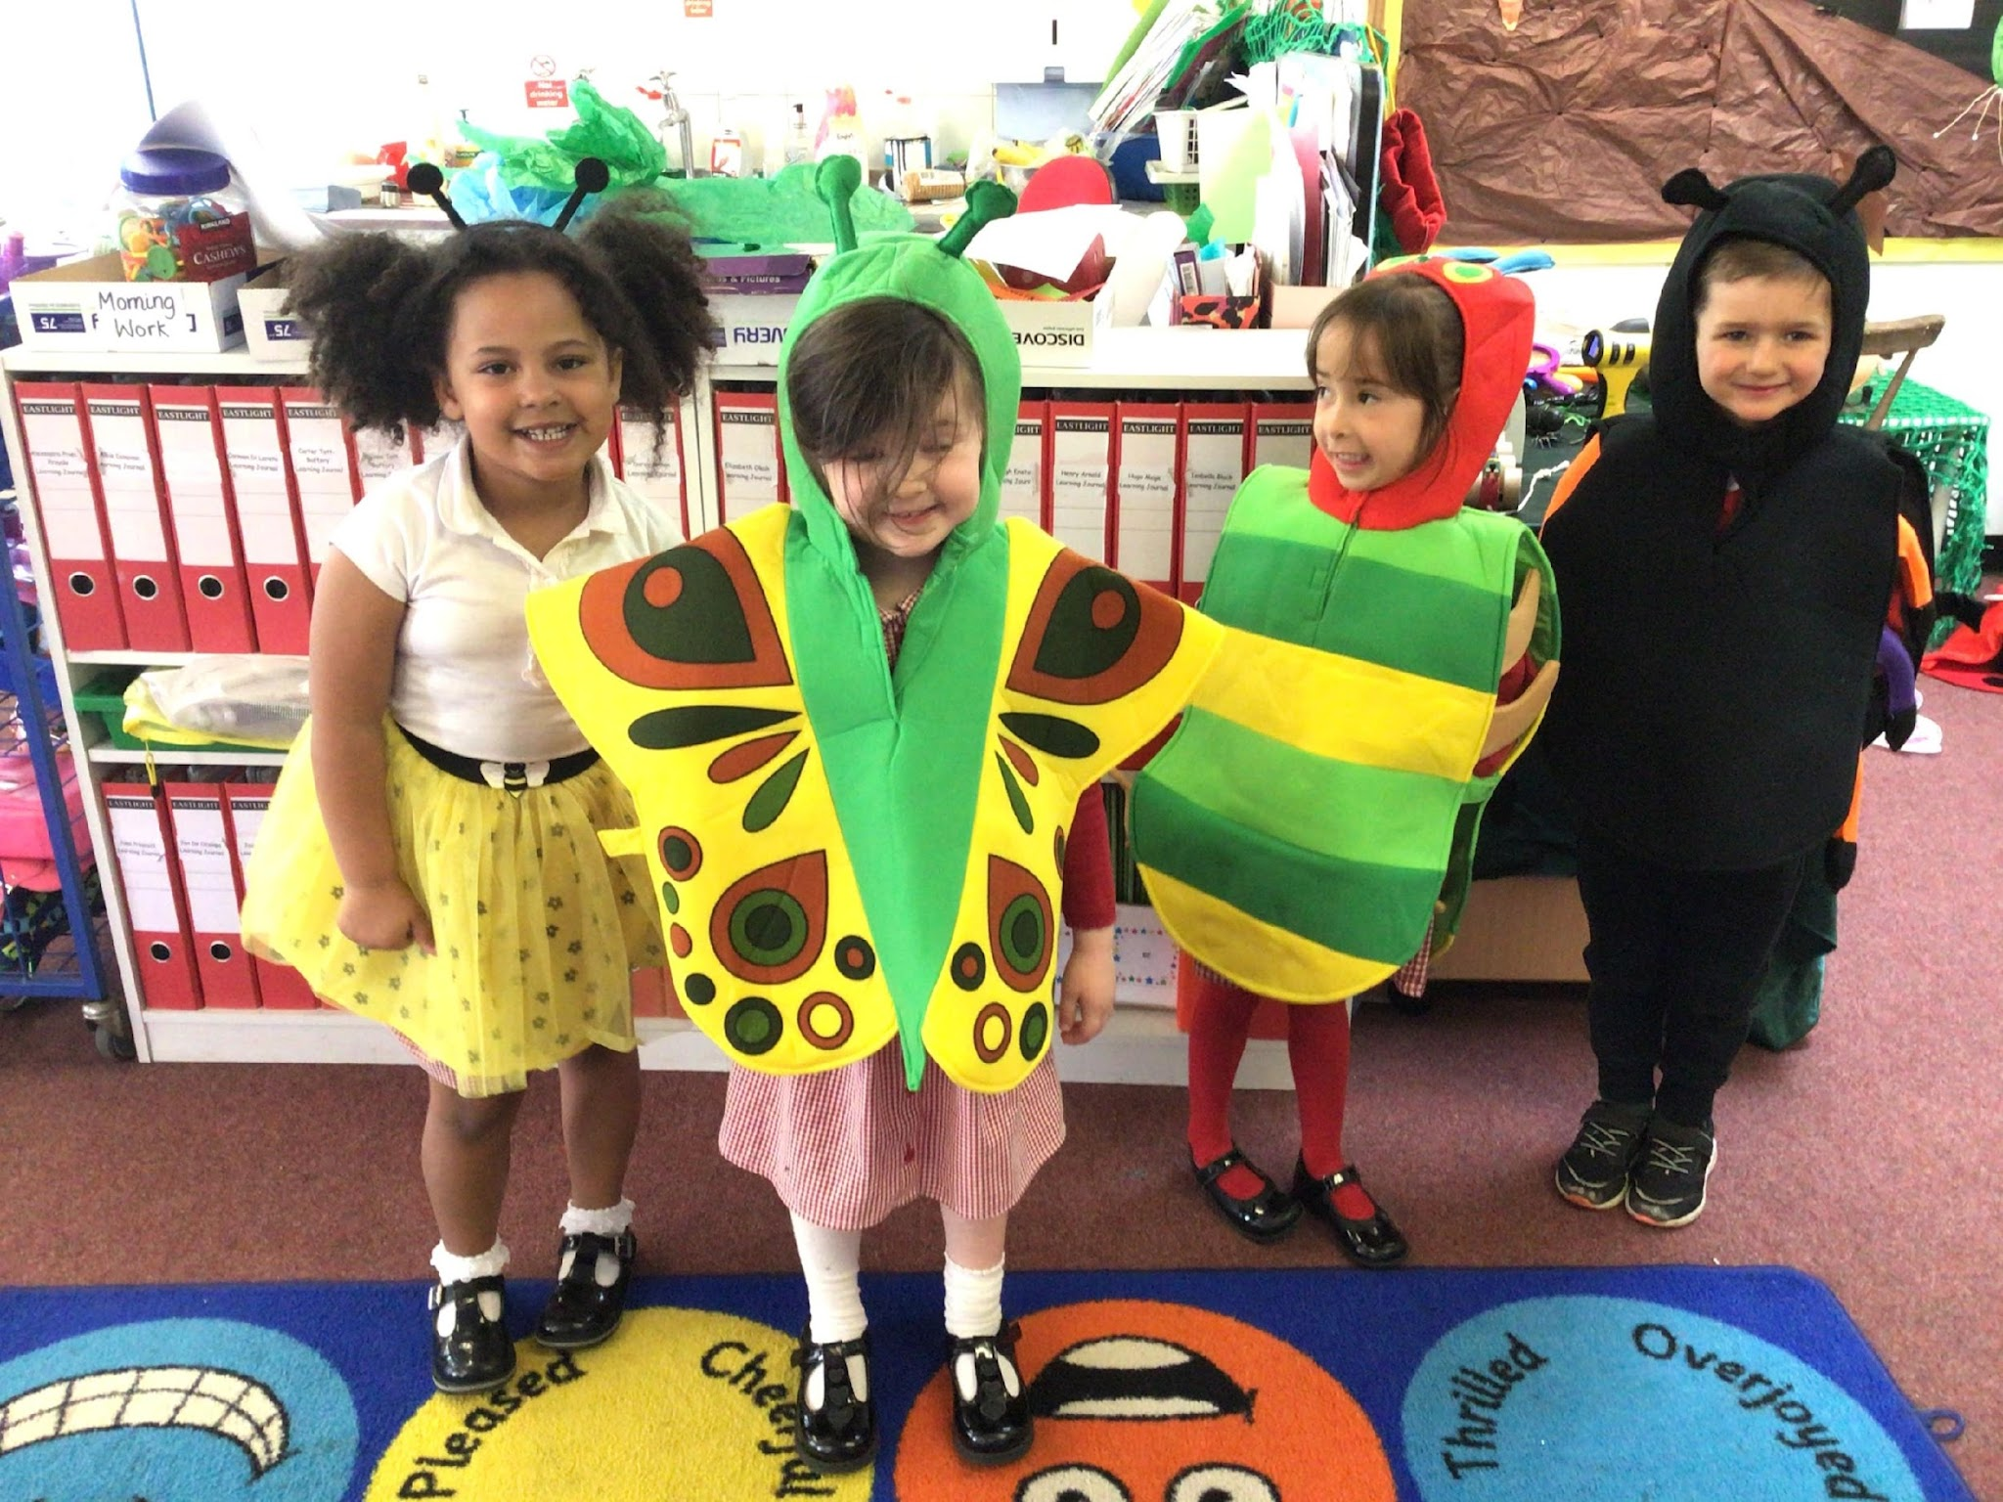
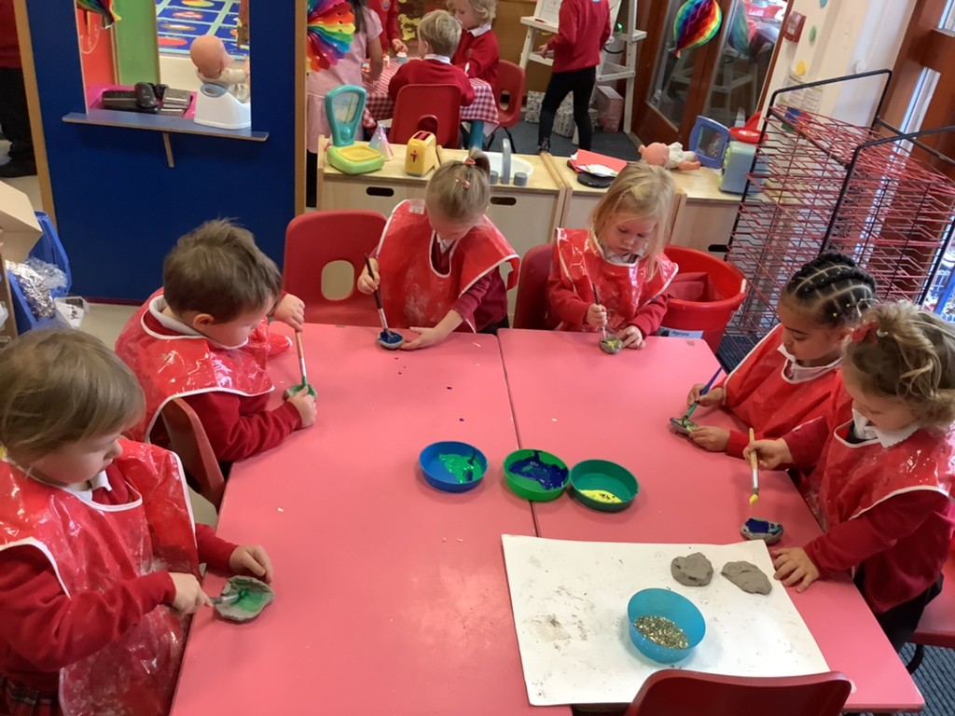
2025-2026
St Bernadette Catholic Primary School
“Learning to grow in knowledge, faith and love through friendship with Jesus and Mary.”
Welcome to Nursery
Birthday Tea Party
Cultural Day
PE Lessons
Sharing Stories
Writing Words
Messy Play!
Minibeast Role Play
Diwali ‘Diya’ Lamps
Notes:
Welcome to St Bernadette’s & hello
One form entry school ranging from Nursery to Y6
Plan for the morning: talk about our school and the EYFS, ending in opportunities for questions and a tour of our outdoor areas

Slide 2
St Bernadette Catholic Primary School
“Learning to grow in knowledge, faith and love through friendship with Jesus and Mary.”
Our Ethos
Our School is proud of its strong community. We value our partnership with parents, parishes and the wider community.
We are a school and church community, a family, promoting core Gospel values of compassion, respect for self and others, responsibility and honesty.
We believe that every child can succeed in life if challenged and inspired appropriately.
Notes:
We are a Catholic School so a part of our school ethos is instilling the Gospel Values within the children
Despite having religious opportunities within our school days, I want to stress that it is not necessary for you/your children to follow the Catholic faith

Slide 3
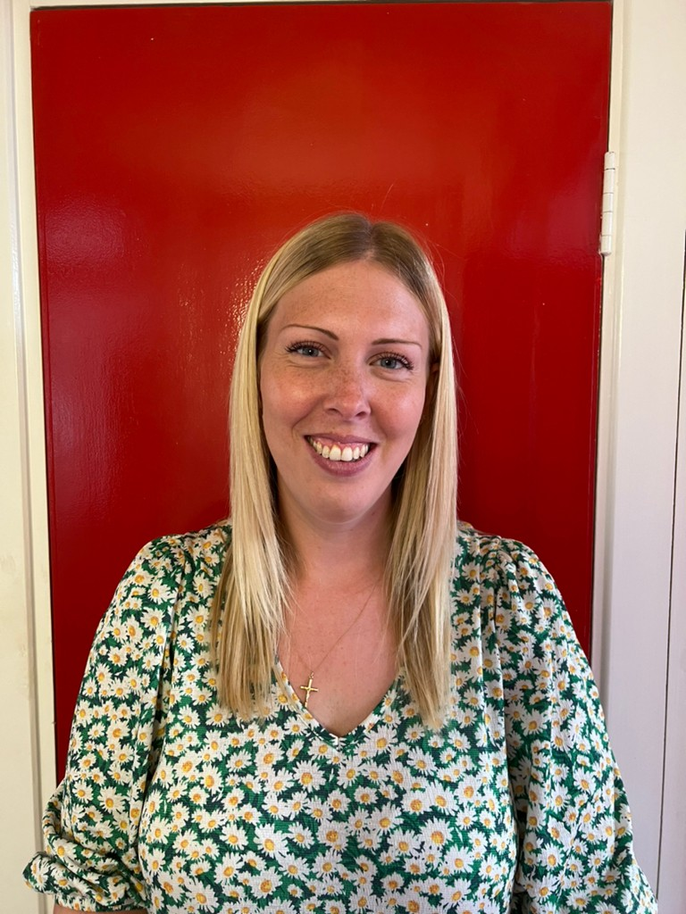
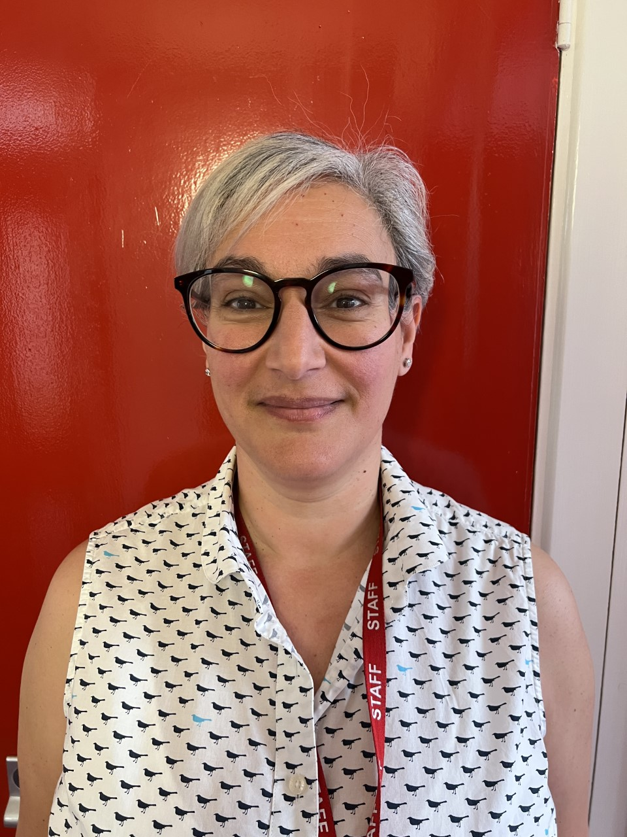
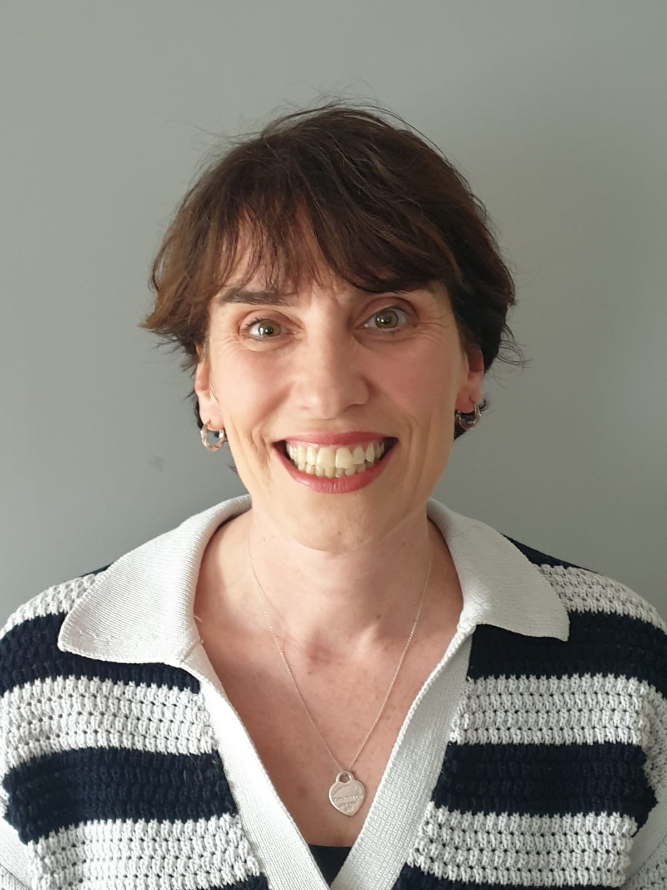
St Bernadette Catholic Primary School
“Learning to grow in knowledge, faith and love through friendship with Jesus and Mary.”
Meet the Team
Miss Weston
(Nursery Class Teacher)
Mrs Campanella
(Early Years Practitioner)
Mrs Heatley
(Reception Teacher &
Early Years Leader)

Slide 4
St Bernadette Catholic Primary School
“Learning to grow in knowledge, faith and love through friendship with Jesus and Mary.”
Nursery school day is 8:45am - 11:45am
Adults say goodbye at the door then the children come inside the classroom
Throughout your child’s time in nursery, they will be taking part in planned lessons;
Daily Phonics
Daily Maths
RE (every Monday)
Music (every Thursday)
Computing (every Thursday)
PE (every Friday)

Slide 5
St Bernadette Catholic Primary School
“Learning to grow in knowledge, faith and love through friendship with Jesus and Mary.”
EYFS Curriculum
The Early Years Foundation Stage (EYFS) sets standards for the learning, development and care of your child from birth to 5 years old.
All schools and Ofsted-registered early years providers must follow the EYFS, including childminders, preschools, nurseries and school reception classes.
Prime Areas of Learning
Communication and Language |  | Physical Development |  | Personal, Social, Emotional Development
Specific Areas of Learning
Literacy | Maths |  | Understanding the World |  | Expressive Art and Design
Notes:
Unlike children in the older years, the EYFS curriculum is very different
We do not have subjects, instead we plan activities that link to 7 areas of learning; 3 Prime Areas and 4 Specific Areas
It is the Prime Areas that are the fundamentals in order for the Specific Areas to work
These areas essentially are similar to subjects (go through the links/what they entail)

Slide 6
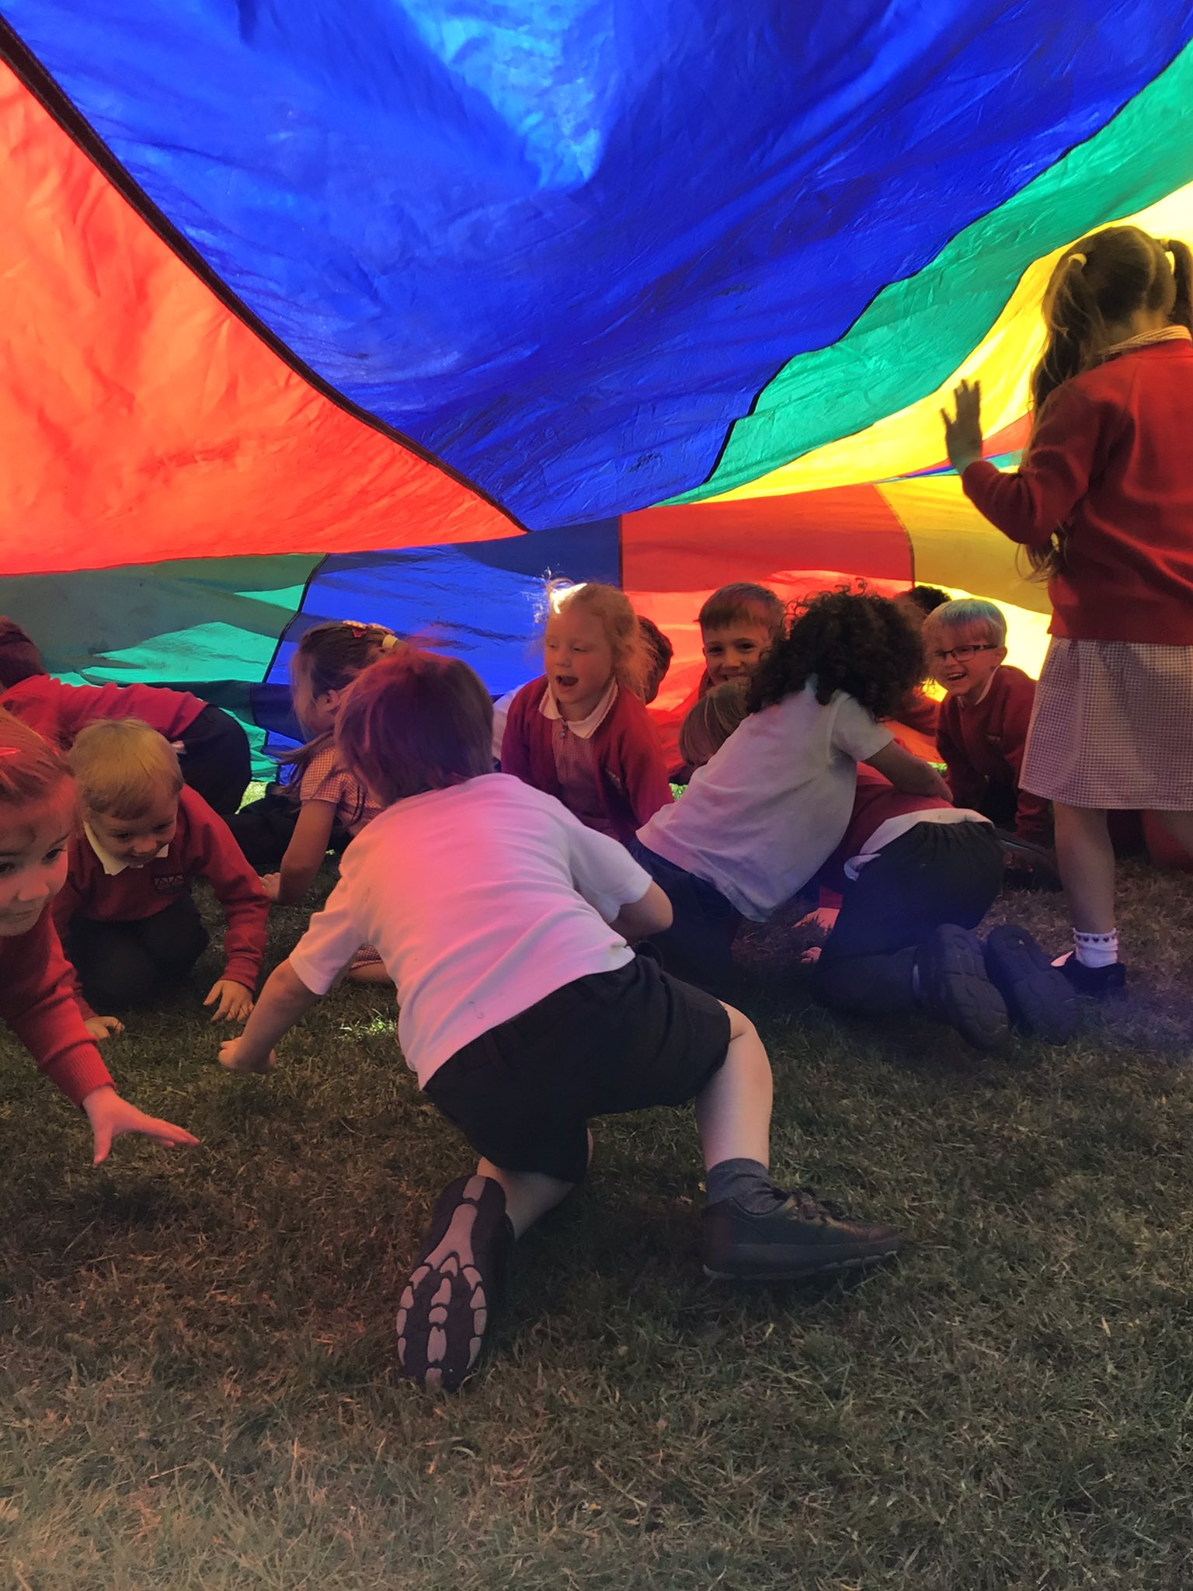
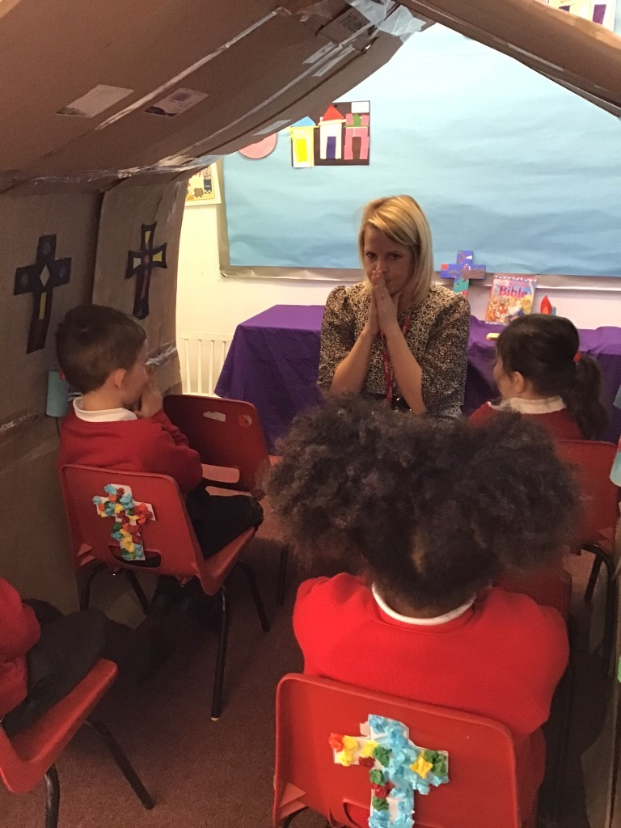
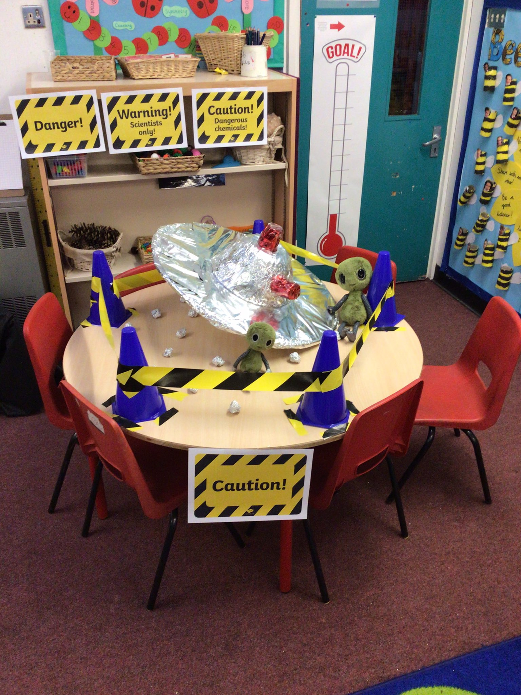
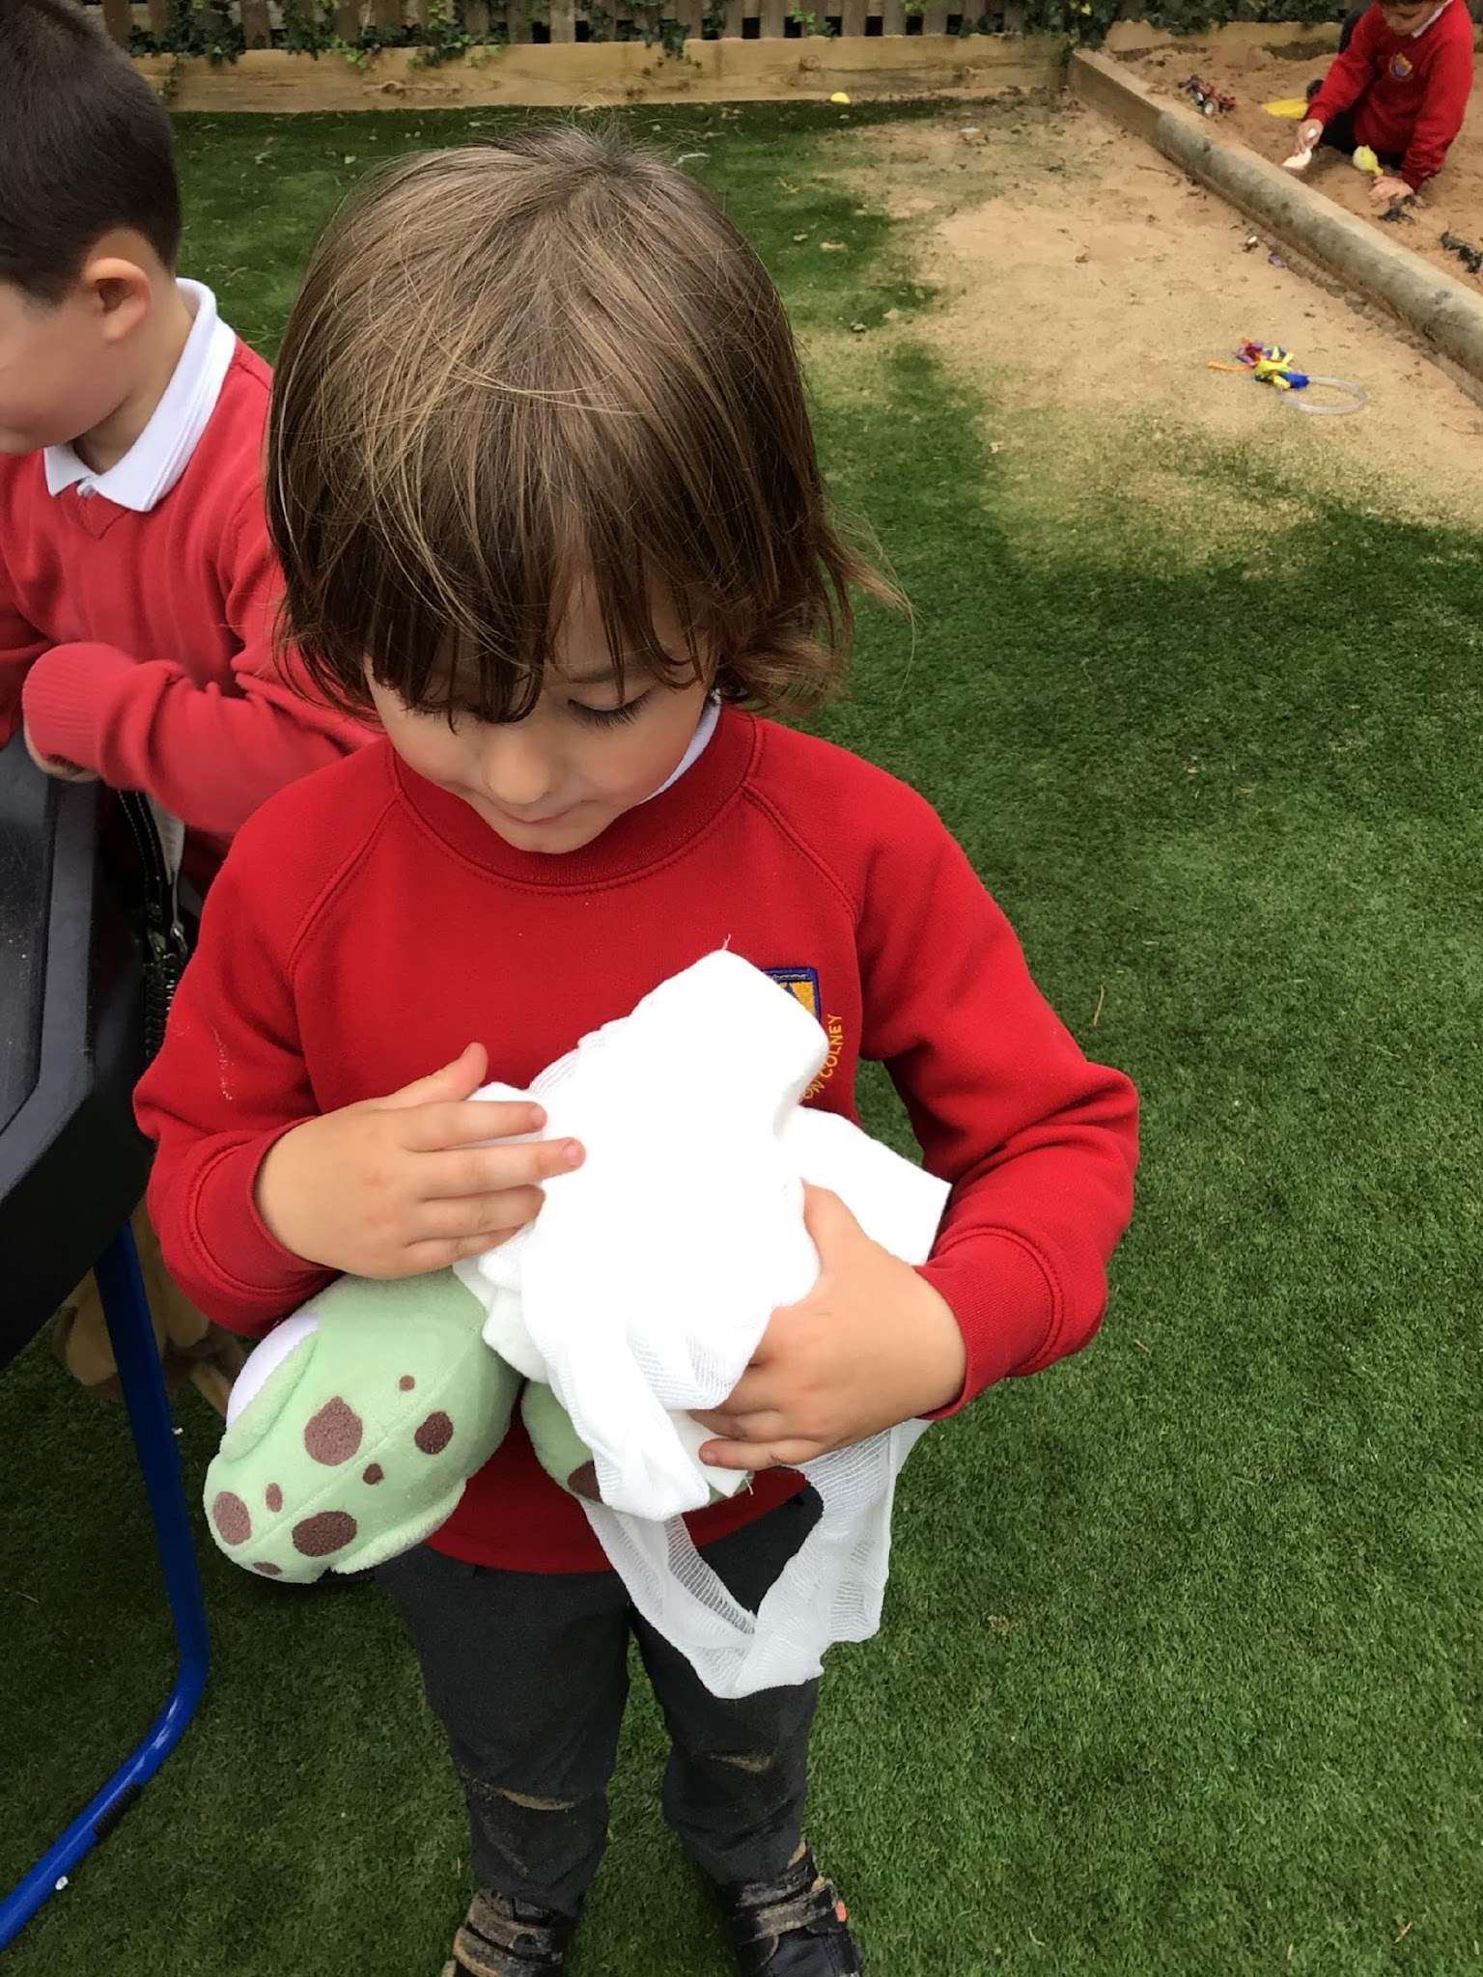
St Bernadette Catholic Primary School
“Learning to grow in knowledge, faith and love through friendship with Jesus and Mary.”
EYFS Curriculum - In and out
Each day, different activities are set up in our indoor and outdoor areas for CIL. This is time where the children can initiate their own learning and choose what areas they would like to be in. At this time, the children can flow freely from inside and outside.
Save the Turtles!
Parachute Fun!
Church Role Play
Alien Crash Landing!

Slide 7
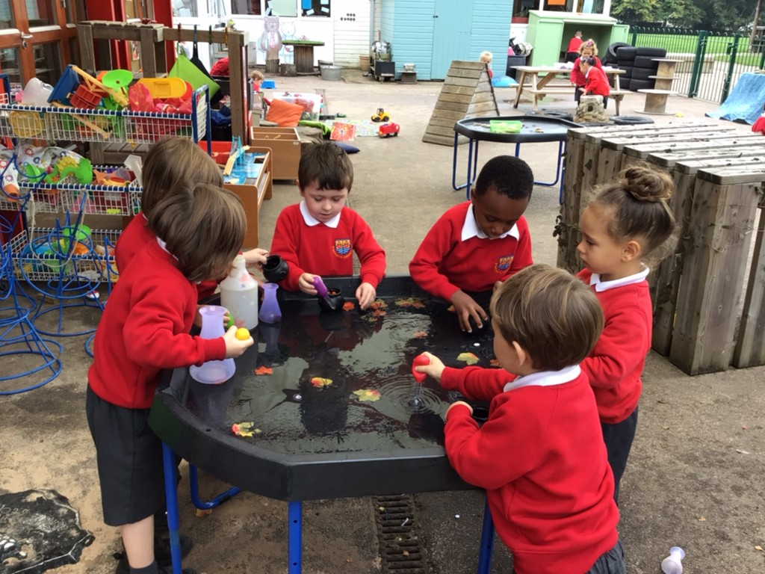
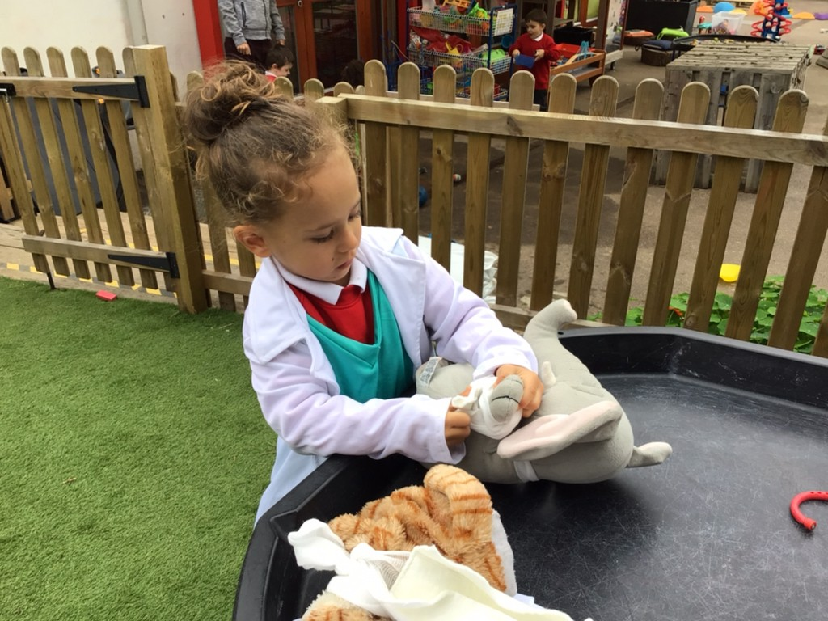
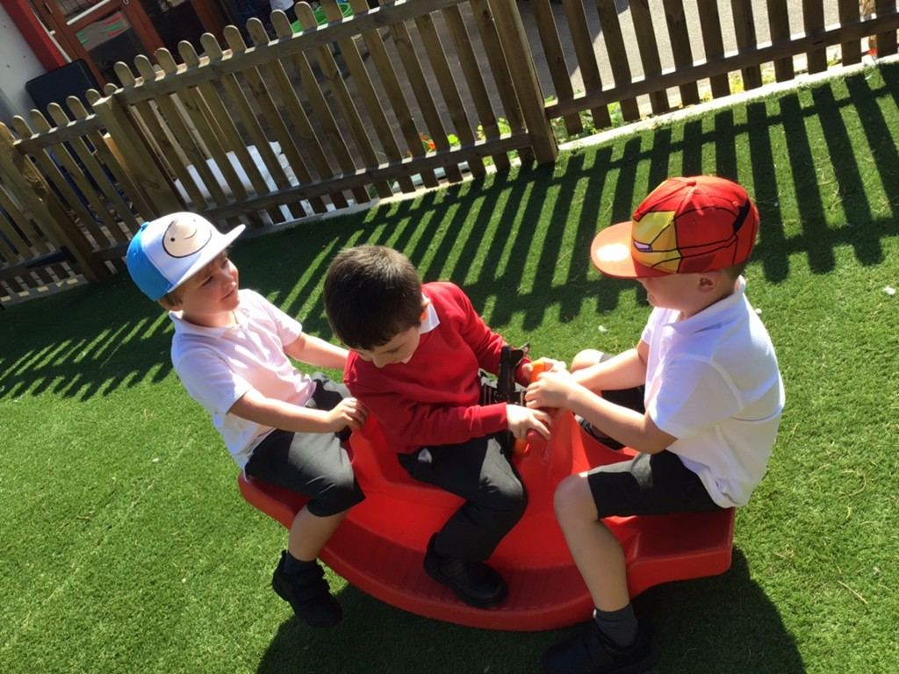
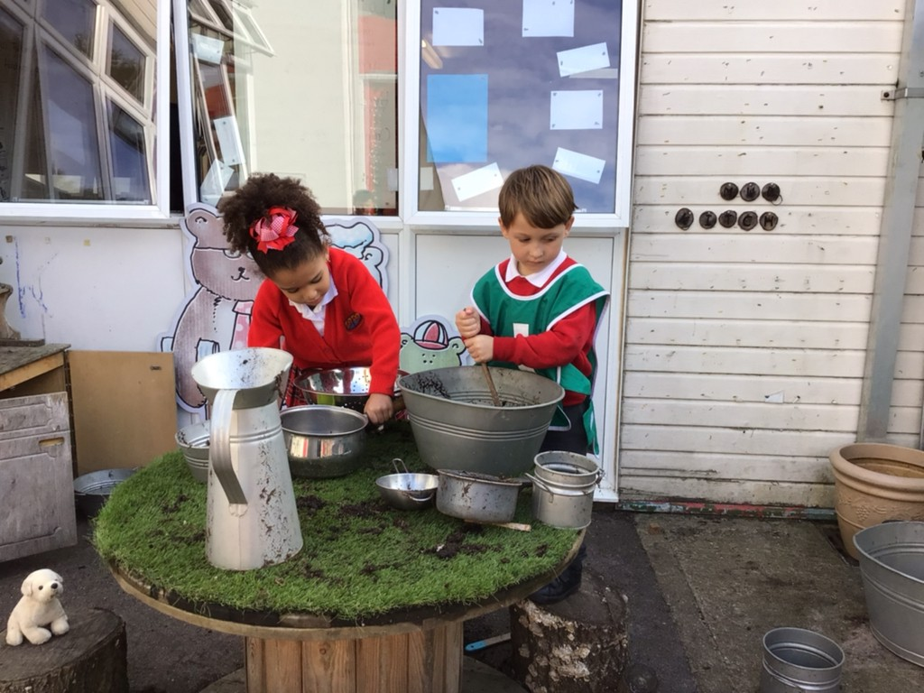
St Bernadette Catholic Primary School
“Learning to grow in knowledge, faith and love through friendship with Jesus and Mary.”
EYFS Curriculum - outdoor area
We are very fortunate here at St Bernadette to have lots of grounds for the children to use. In the Early Years, we do the majority of our learning in our indoor and outdoor area.
Potion Making
Vet Role Play
Building Relationships
Mud Kitchen

Slide 8
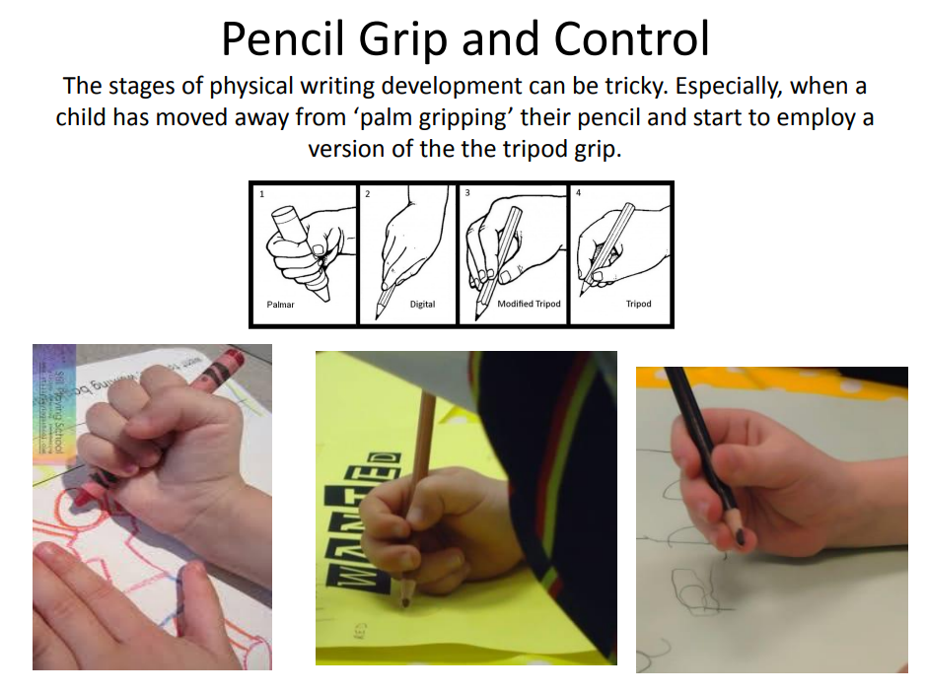
St Bernadette Catholic Primary School
“Learning to grow in knowledge, faith and love through friendship with Jesus and Mary.”

Slide 9
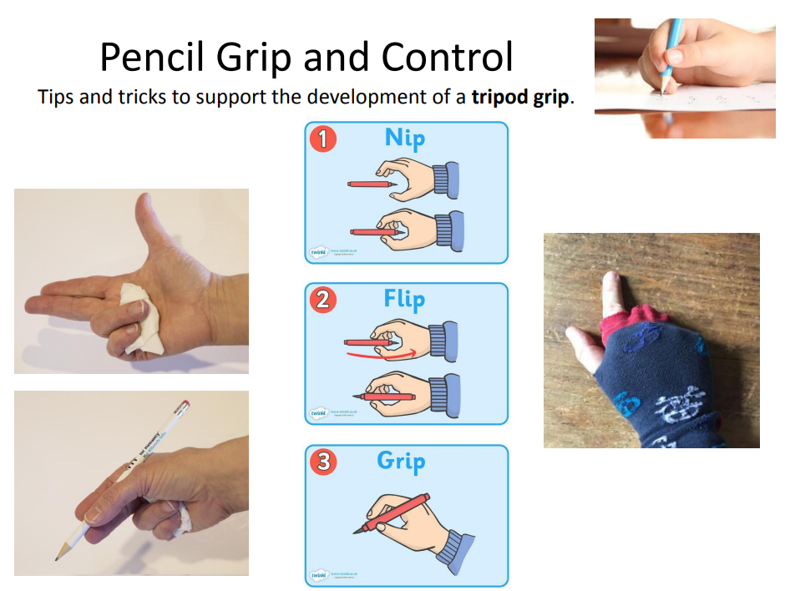
St Bernadette Catholic Primary School
“Learning to grow in knowledge, faith and love through friendship with Jesus and Mary.”

Slide 10
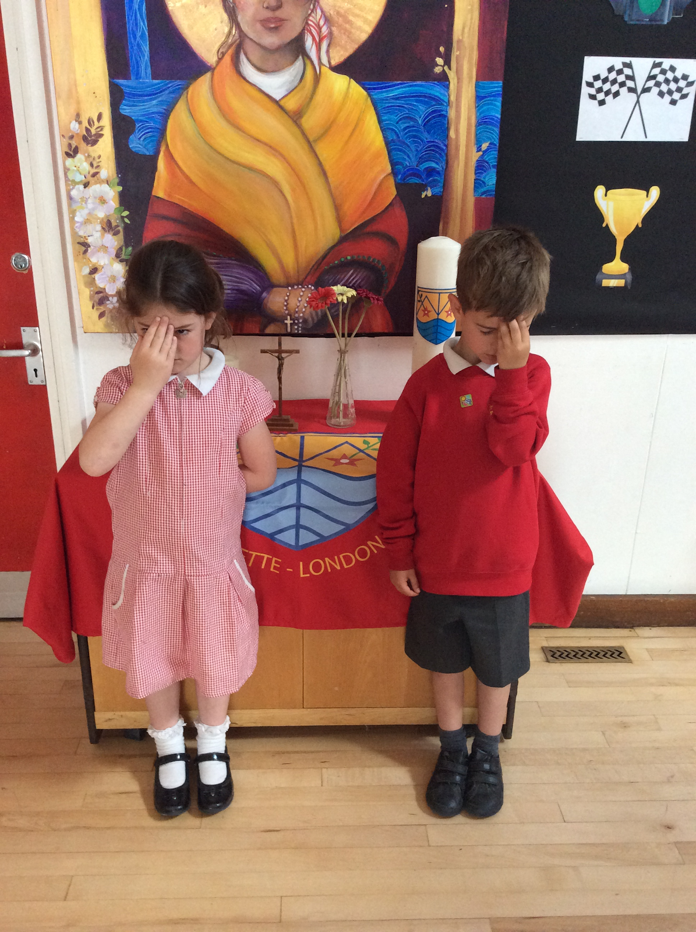
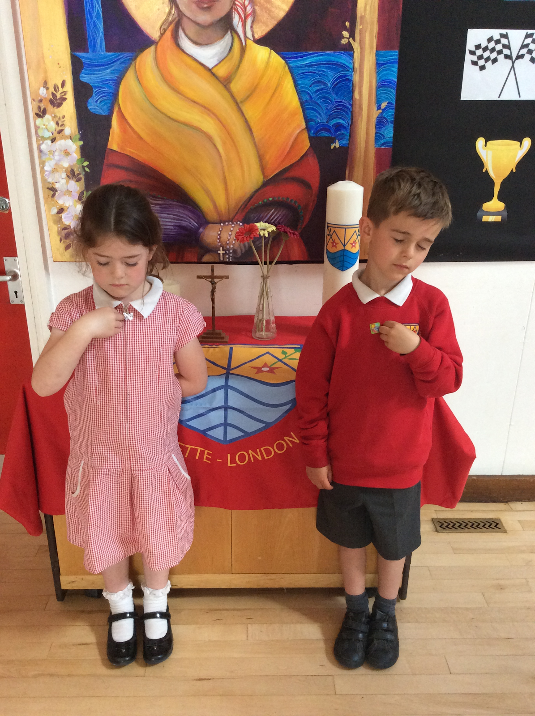
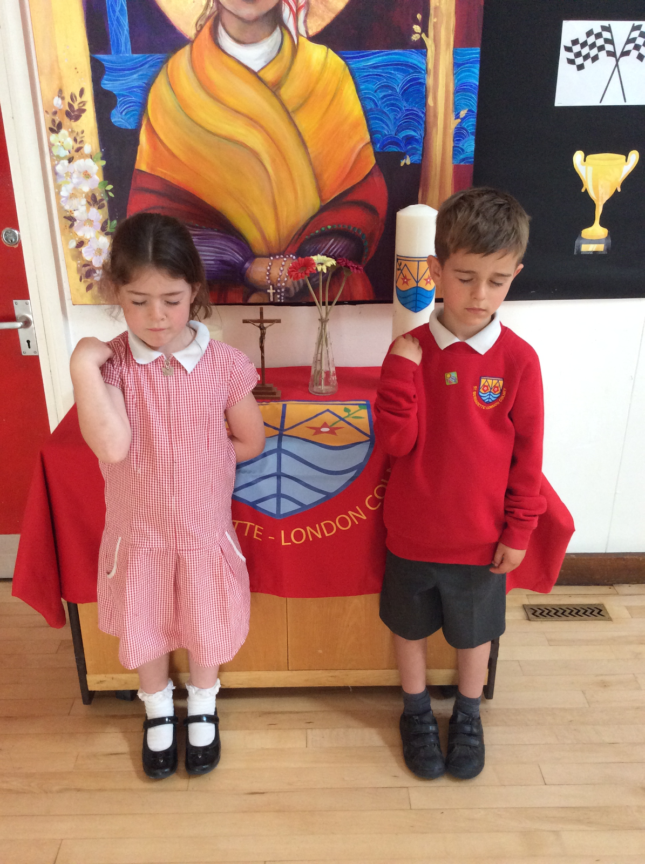
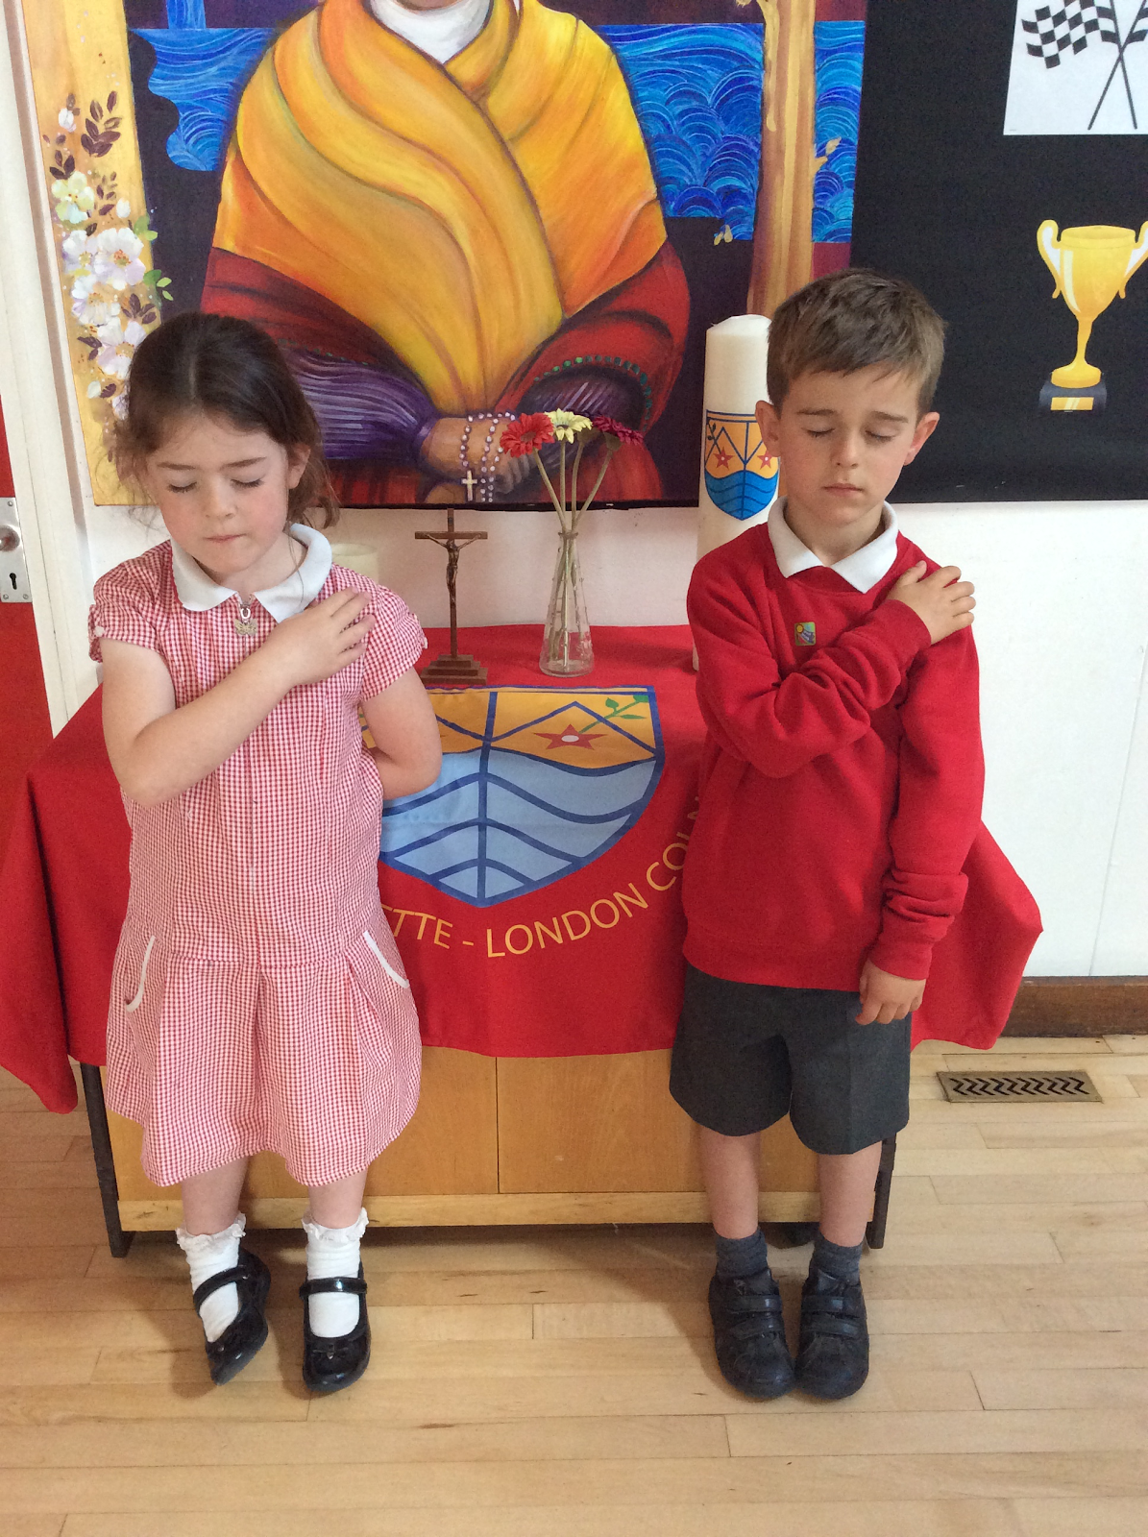
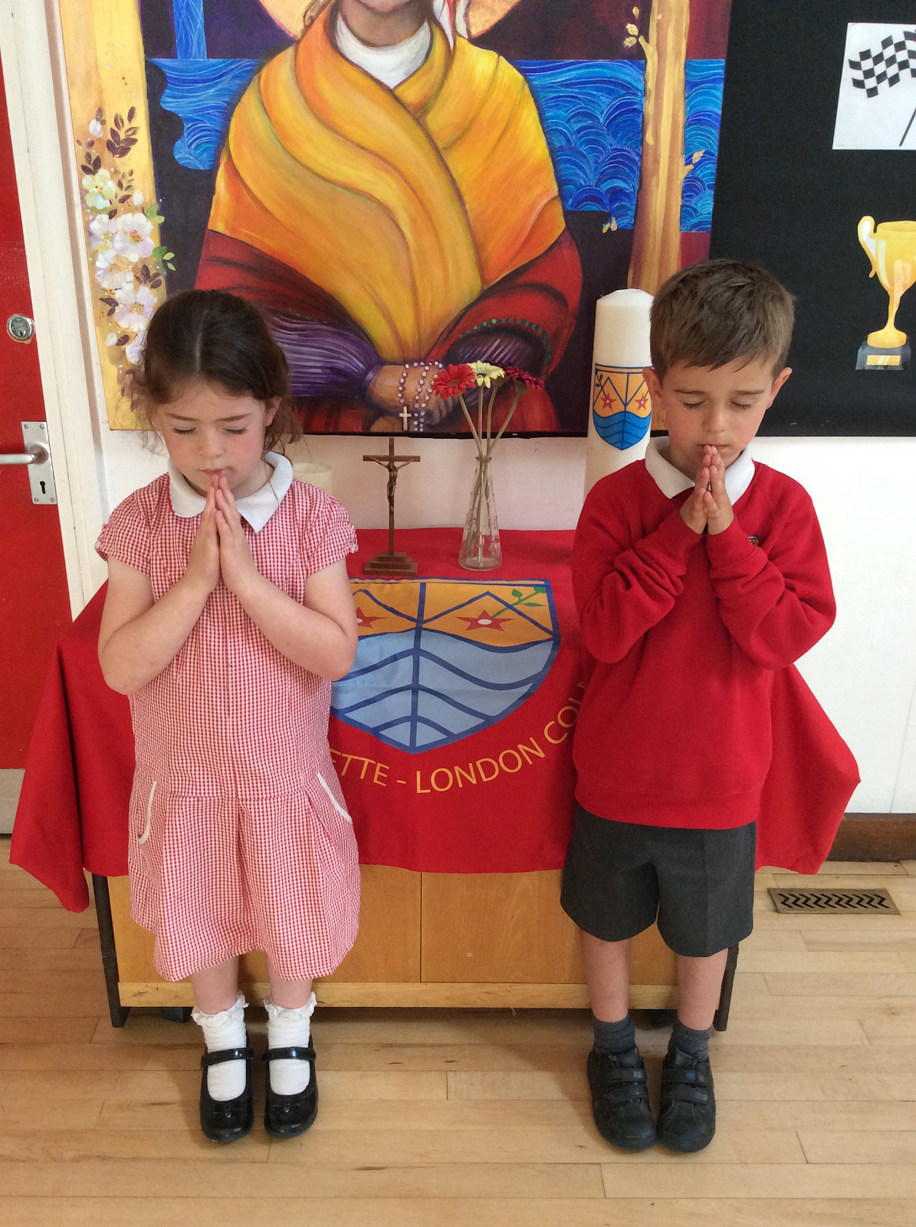
St Bernadette Catholic Primary School
“Learning to grow in knowledge, faith and love through friendship with Jesus and Mary.”
Morning Prayer
In the name of the Father, the son and the Holy Spirit, Amen
God our Father I come to say, help me make good choices today,
In the name of the Father, the son and the Holy Spirit, Amen
Praying at School
Praying is a very important part of our curriculum and in Nursery we teach RE once a week on a Monday. We also have a daily Collective Worship time, where we link our RE learning with a class discussion (i.e Jesus was kind, how have you been kind today?)
End of Day Prayer
In the name of the Father, the son and the Holy Spirit, Amen
God our Father, we close our eyes and softly say, thank you for our learning today. Amen
In the name of the Father, the son and the Holy Spirit, Amen
In the name of the Father
And of the Son
And of the Holy
Spirit
Amen.
Notes:
As we are a Catholic School, prayer is a part of our day
The children in Nursery pray two times a day (upon arrival and upon dismissal) they also learn how to make the sign of the cross
The Children also take part in a RE lesson which could focus on our Catholic Faith but also different Faiths and different Cultures

Slide 11
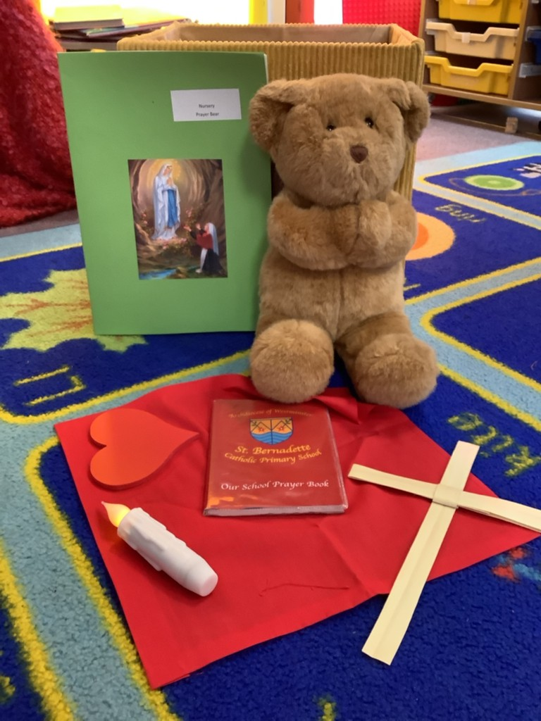
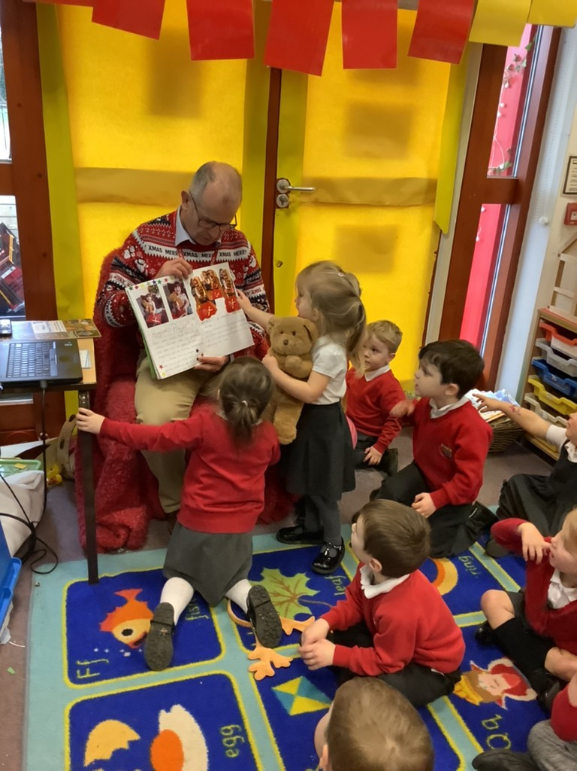
St Bernadette Catholic Primary School
“Learning to grow in knowledge, faith and love through friendship with Jesus and Mary.”
Prayer Bear
The lower classes in the school have each been allocated a ‘Prayer Bear’. Prayer Bear gets to go home with a different child every week.
Prayer Bear has its very own belongings, including a prayer book, where the children can draw pictures of people they want to pray for with the support of their family members. This is then shared with the class, before given to the next child.
Prayer Bear
Presenting Prayer Bear
Notes:
One of the latest things we have introduced is Prayer Bear, which works a little like the typical class bear

Slide 12
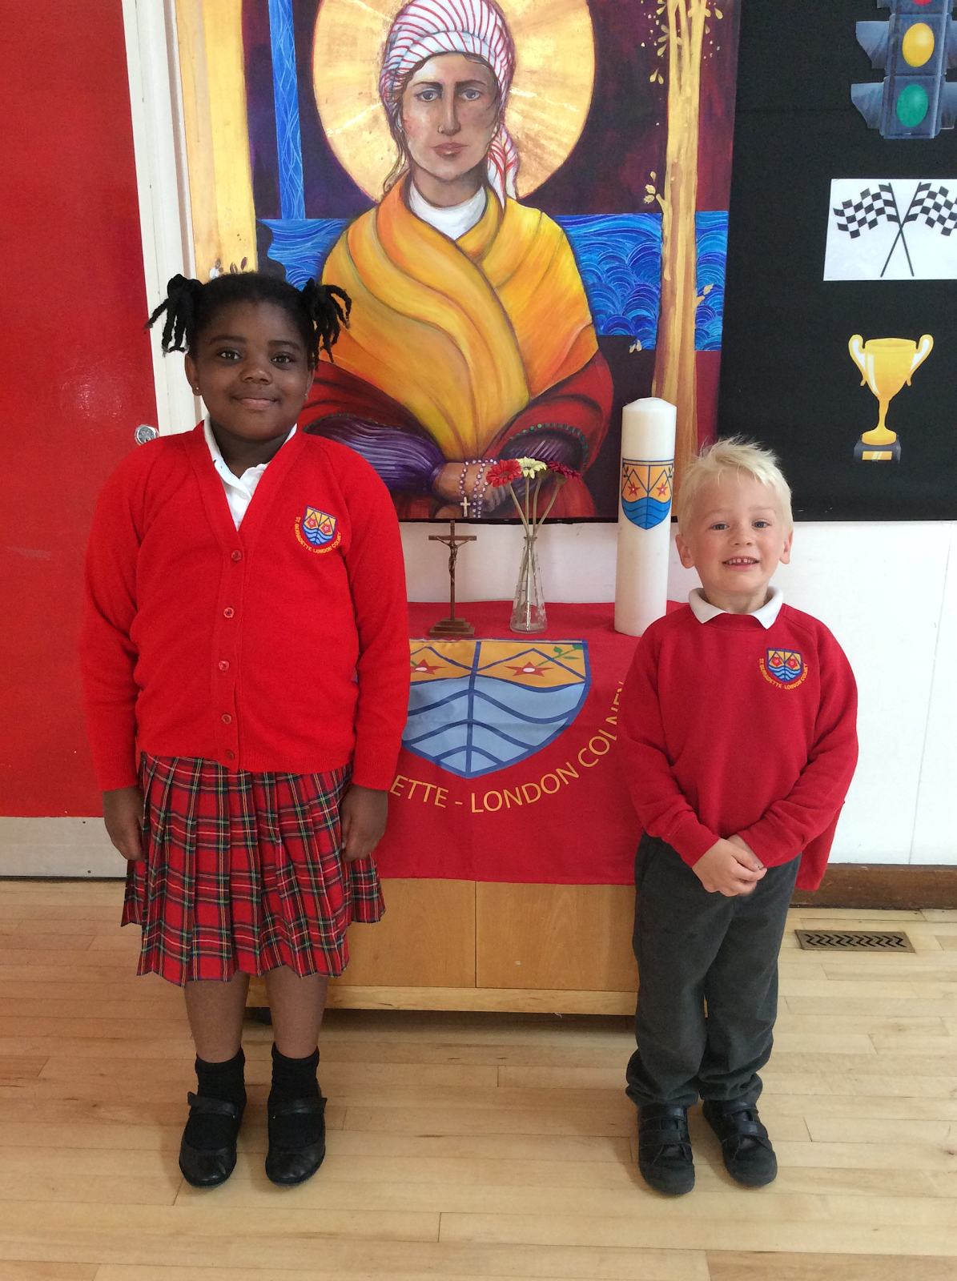
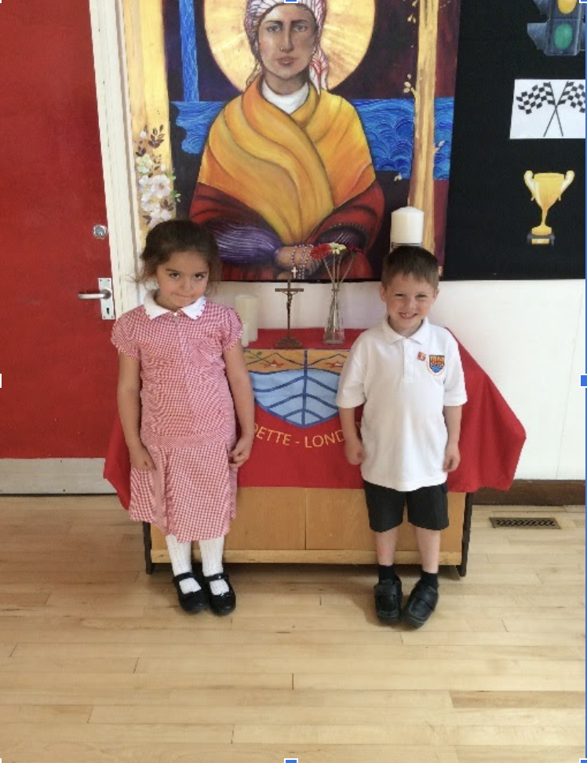
St Bernadette Catholic Primary School
“Learning to grow in knowledge, faith and love through friendship with Jesus and Mary.”
Uniform
Winter Uniform
Summer Uniform
Stockists
Stevensons (St Albans) is the supplier for all school uniform.
Winter/Summer Hats and book bags are available from the school office.
Other items are readily available in high street stores.
Footwear should be suitable low heeled school shoes. Open toes and sling backs are not allowed for safety reasons.
For health reasons, trainers are only allowed to be worn for PE and playtimes.
Grey shorts/trousers with socks
Red kilt/grey skirt with socks
Red jumper/cardigan
Red gingham dress for the Summer term and until October half-term
White Shirt
Black sensible shoes (not laced for Y1 below)

Slide 13
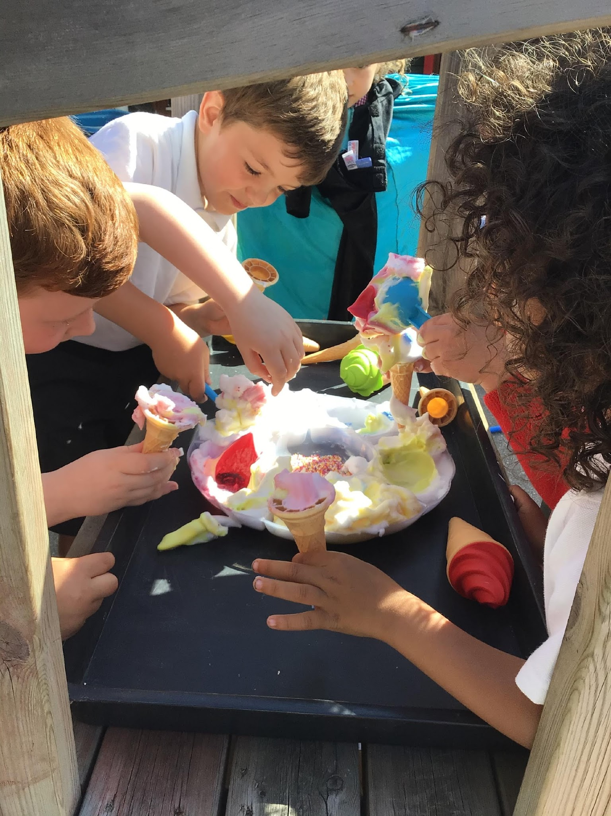
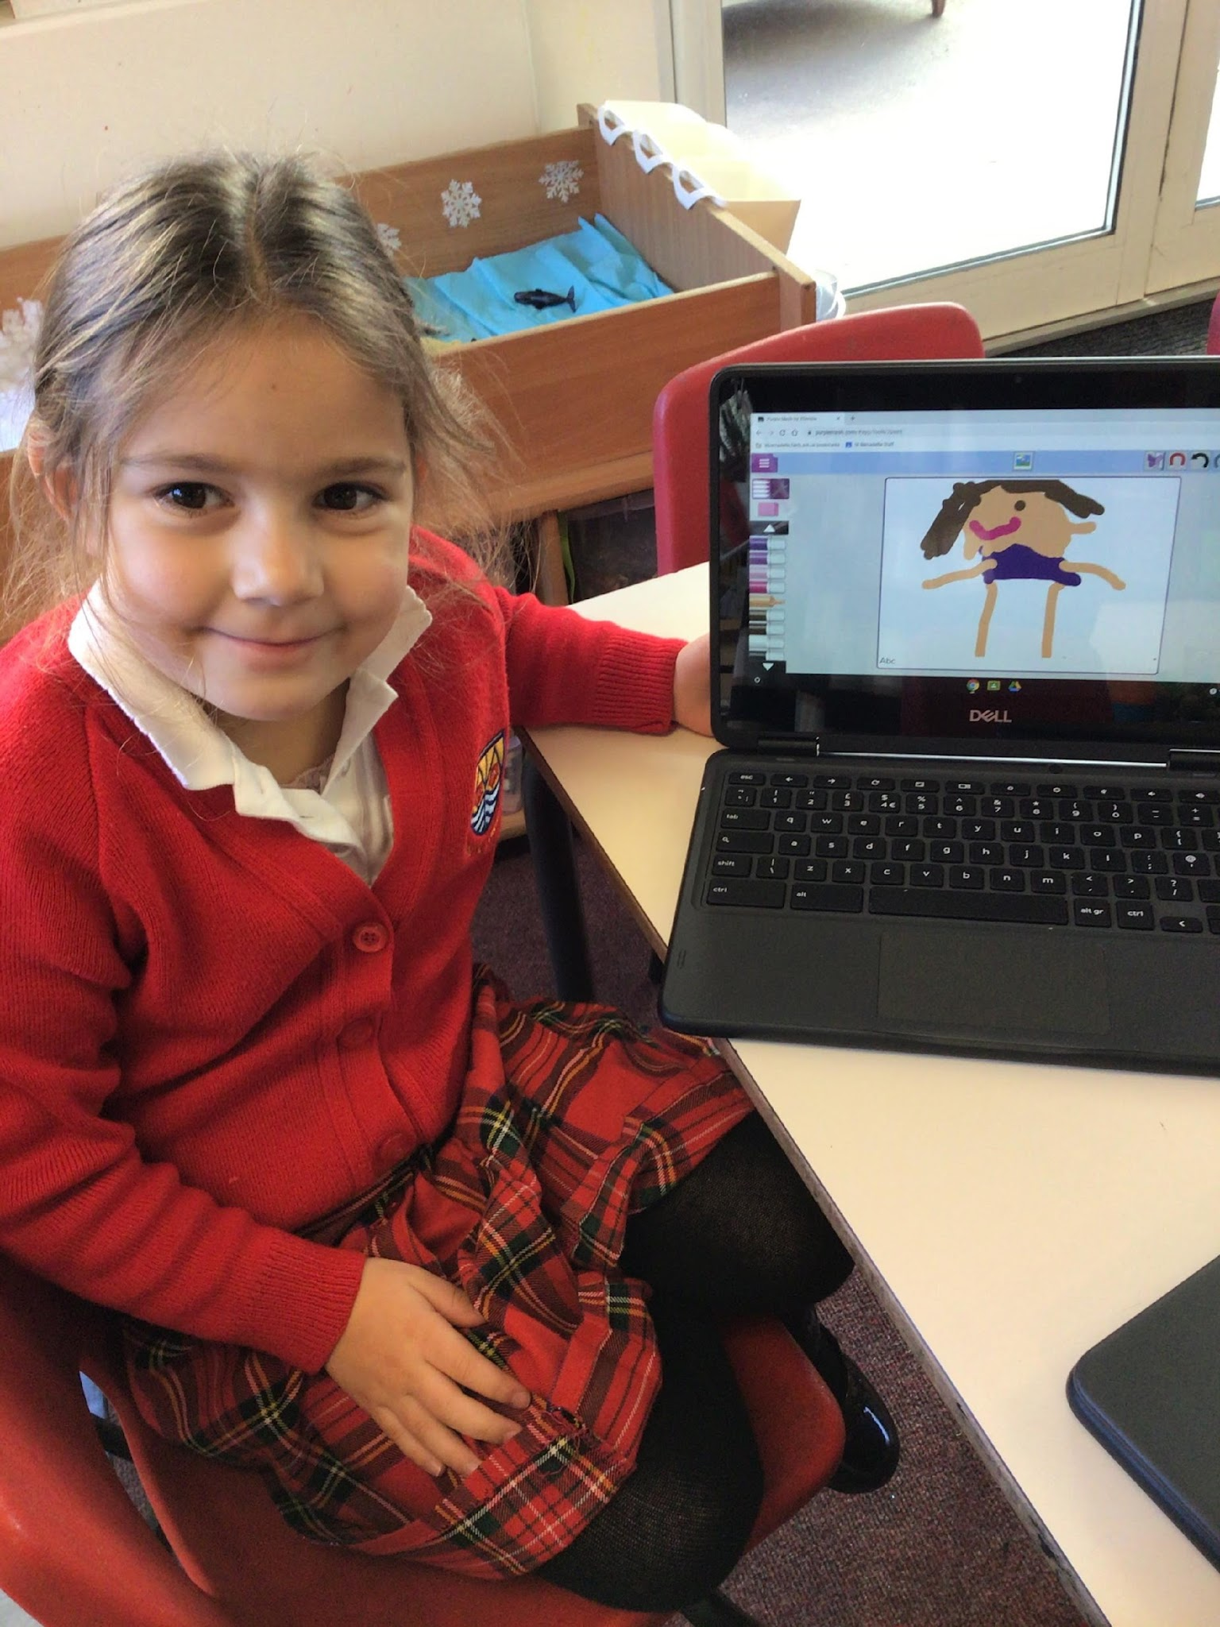
St Bernadette Catholic Primary School
“Learning to grow in knowledge, faith and love through friendship with Jesus and Mary.”
Tapestry
We use an online learning journal called Tapestry. This is where we gather photos and observations – recording your child’s progress in their learning.
We use this platform to share ‘WOW’ moments with you and to share important information.
As this is an online profile we will need your permission to set up your child’s account.
Technology
Ice Cream Parlour
Notes:
One of the things we do to ensure good communication between EYFS staff and you as parents, is our use of Tapestry
Tapestry is an online learning platform, where staff can upload videos/images of your child which can be shared with you at home
We upload WOW moments of your child throughout the week which you at home can like and comment on- it essentially gives you an inside picture of what happened on that day!
Additionally messages can be uploaded by staff or family for each other to see
Another great use of it is sharing photos for show and tell- parents often upload posts to update us on their holiday whereabouts, which we can share with the other children in the class

Slide 14
St Bernadette Catholic Primary School
“Learning to grow in knowledge, faith and love through friendship with Jesus and Mary.”
Parent Partnership
We like to welcome parents into nursery to join our learning. These are the times you will be invited in;
Autumn 2 - Christmas Party
Spring 1 - Valentines Day gathering / Culture Day
Spring 2 - Mother’s Day gathering
Summer term - Secret Story Teller
Summer 2 - Father’s Day gathering / Sports Day / Graduation Party
Parents consultations - Autumn 2 term and Spring 2 term

Slide 15
St Bernadette Catholic Primary School
“Learning to grow in knowledge, faith and love through friendship with Jesus and Mary.”
The Village Pre School
The Village Pre-School is run from the old Nursery on our premises. They take children from the age of 2 upwards.
They will collect children in our current nursery for afternoon provision for those families wanting to use the 30 hrs childcare provision.
They also offer Breakfast Club and After school club.
Notes:
On our school grounds, also stands our old Nursery building
This has been transformed over the last summer into a Pre-School
It is run by a qualified Teacher
If you require afternoon provision, then this could be the approach for you
The Pre School Staff come to the Nursery door and escort the children through the KS1 playground over to the Pre-School (the children will not have to leave the school premises in order to do this).
I will show you this later on

Slide 16
St Bernadette Catholic Primary School
“Learning to grow in knowledge, faith and love through friendship with Jesus and Mary.”
Home visits
Before your child starts Nursery, we visit you and your child at home in September.
Home Visits are a really valuable way of ensuring you are able to share information about your child.
It is also an opportunity for us to share practical arrangements ready for your child starting Nursery.
Notes:
Before your child starts at our Nursery- we want to ensure that the transition to us is a smooth as possible
In order for this to happen, we invite you as parents to meet with our staff in order to share some information about your child so that we have some prior information on them before they start
Usually this would look like a home visit, but as the Pandemic has made this rather difficult and unrealistic, we have instead opted to inviting you and your child to our school.
Here they can meet their teacher, explore the classroom and the outdoor area!

Slide 17
St Bernadette Catholic Primary School
“Learning to grow in knowledge, faith and love through friendship with Jesus and Mary.”
First Week in September
Wednesday 2nd September | Thursday 3rd September | Friday 4th September
Inset Day | Home visits - Batch 1 | Home visits - Batch 2
At this Welcome meeting you will be given your child’s Home visit date and time
Your child is expected at these appointments
We are unable to change the day and time - if you can not make it please speak with myself
Notes:
Before your child starts at our Nursery- we want to ensure that the transition to us is a smooth as possible
In order for this to happen, we invite you as parents to meet with our staff in order to share some information about your child so that we have some prior information on them before they start
Usually this would look like a home visit, but as the Pandemic has made this rather difficult and unrealistic, we have instead opted to inviting you and your child to our school.
Here they can meet their teacher, explore the classroom and the outdoor area!

Slide 18
St Bernadette Catholic Primary School
“Learning to grow in knowledge, faith and love through friendship with Jesus and Mary.”
First Day
Monday 7th September | Group A (8:45am-10:15am) Group B (10:30am-11:45am)
Tuesday 8th September | ALL children in (8:45am-11:45am)
At this Welcome meeting you will be given your child’s Group
Notes:
Before your child starts at our Nursery- we want to ensure that the transition to us is a smooth as possible
In order for this to happen, we invite you as parents to meet with our staff in order to share some information about your child so that we have some prior information on them before they start
Usually this would look like a home visit, but as the Pandemic has made this rather difficult and unrealistic, we have instead opted to inviting you and your child to our school.
Here they can meet their teacher, explore the classroom and the outdoor area!

Slide 19
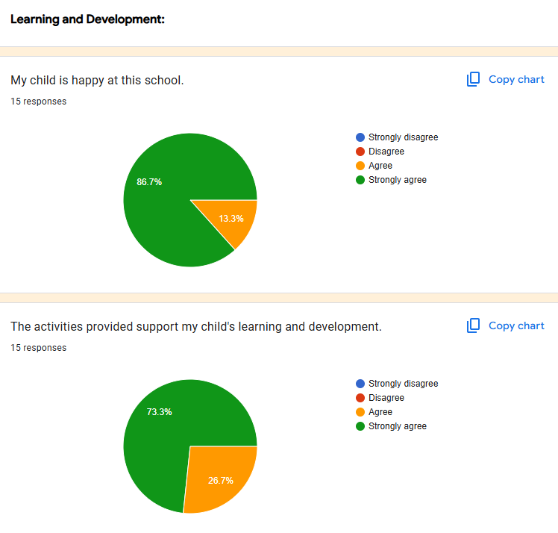
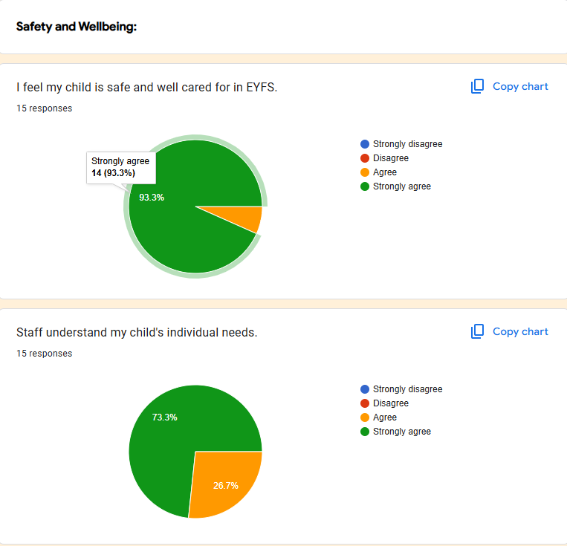
Parent Survey January 2026

Slide 20
Parent Survey January 2026
Having had two children with your nursery staff, they are absolutely wonderful, caring and so nurturing and you can feel that they love their role. As a parent I feel at ease that my child is well cared and looked after as well as being prepared for hopefully a smooth transition to reception
Mrs Campanella and Miss Weston are such wonderful teachers. They are caring and kind but also don’t stand for any nonsense. They are the perfect pairing to get the children ready for school.
The Nursery team are wonderful and are the best combination for this age group. Young kids need a motherly personality, who will comfort, cuddle and make them laugh and feel safe and Miss Weston and Mrs Campanella are the best.

Slide 21
Any questions?

